Slide 1
Aptitude Preparation
- Nishigandha Kulkarni.

Slide 2
What is Aptitude ?
In Simple terms, “ Natural ability to do something is known as Aptitude ”.
It is like testing your ability to perform tasks and react to situations at work.
E.x:
Problem solving
Prioritization
Numerical skills

Slide 3
Why Aptitude ?
To Crack any competitive exams .
To get through the initials rounds during campus placements.

Slide 4
Where aptitude is needed ?
Campus Placement.
GATE.
GRE.
MBA entrance exams.
Civil Services.
And many more.

Slide 5
Topics Covered in Aptitude ?
Quantitative Aptitude.
Logical Reasoning.
Verbal Ability.

Slide 6
Quantitative aptitude
Numbers
HCF & LCM
Calendars.
Clocks
Alligations and mixtures.
Average
Time and distance
Boats and streams
Problems on trains.
Simple Interest.
Compound Interest

Slide 7
Quantitative aptitude
Decimal fractions
Partnership
Percentage
Probability
Permutation & Combination.
Ages
Profit and loss.
Ratio & Proportion.
Time & Work.
Pipes & Cistern
Works & Wages

Slide 8
Logical Reasoning
Series Completion
Seating Arrangement.
Blood Relations.
Directions.
Coding and Decoding.
Decision Making.

Slide 9
Verbal Ability
Communicating in English is Easiest way to practice grammar.
Reading Newspaper will help here.[Will be added advantage in GD ]
Reading Comprehension.
Para Jumbles
Sentence Correction
Synonyms
Antonyms
Para Completion

Slide 10
How to prepare ?
For Verbal Ability :
Give preference to Grammar.
English Speaking.
Read at least one news paper daily to improve vocabulary.
Solve as many question as you can to improve speed and accuracy.
Believe in whatever written in questions don’t answer based on facts.

Slide 11
How to prepare ?
Logical Reasoning :
Speed is very Important as questions are time consuming.
Prepare your rough work as soon as you get question paper [ for e.g. in series completion write alphabets and its corresponding numbers to save time later it will be used for coding decoding also.]

Slide 12
How to prepare ?
Quantitative Aptitude :
Speed and Accuracy is very important. Try solve maximum questions of maximum types.
Prepare as per following sequence:
Calendars
Clocks
Numbers / Square & Square roots / Cube & Cube roots.
HCF & LCM
Decimal fractions / Basic operations / Logs.

Slide 13
Quantitative Aptitude :
Percentage
Ratio & Proportion
Averages
Ages
Alligations and Mixtures
Probability / Permutation & Combination.
Simple Interest
Compound Interest.
Profit & Loss

Slide 14
Quantitative Aptitude :
Time & Distance
Boats & Streams
Problems on Train
Time and Work
Pipes and Cistern
Works and Wages
Partnership

Slide 15

Examples : Clocks

Slide 16
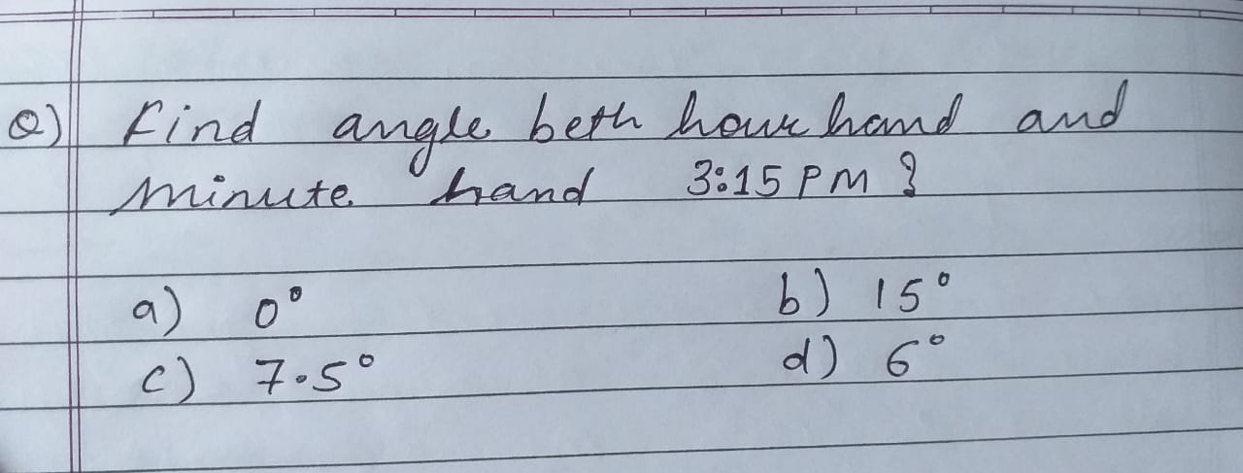

Slide 17
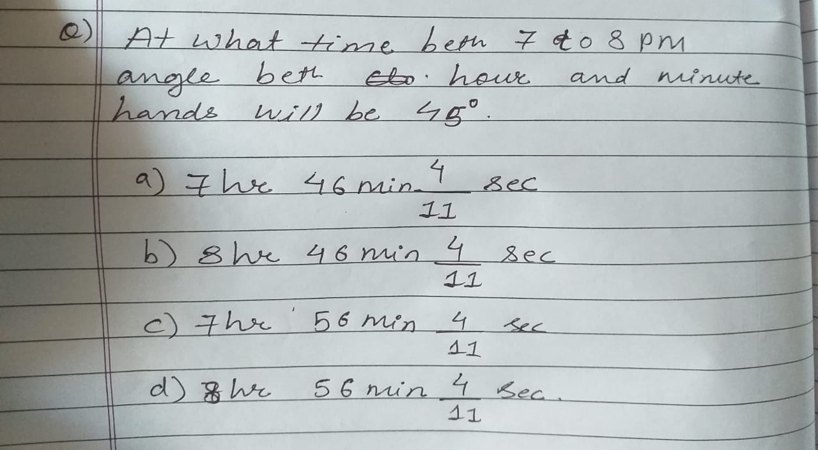

Slide 18
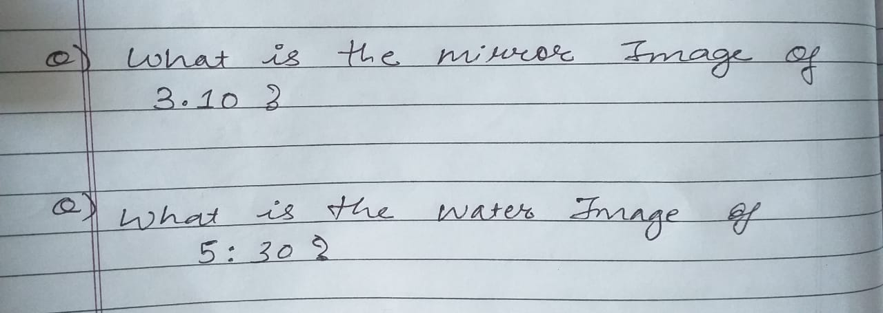

Slide 19
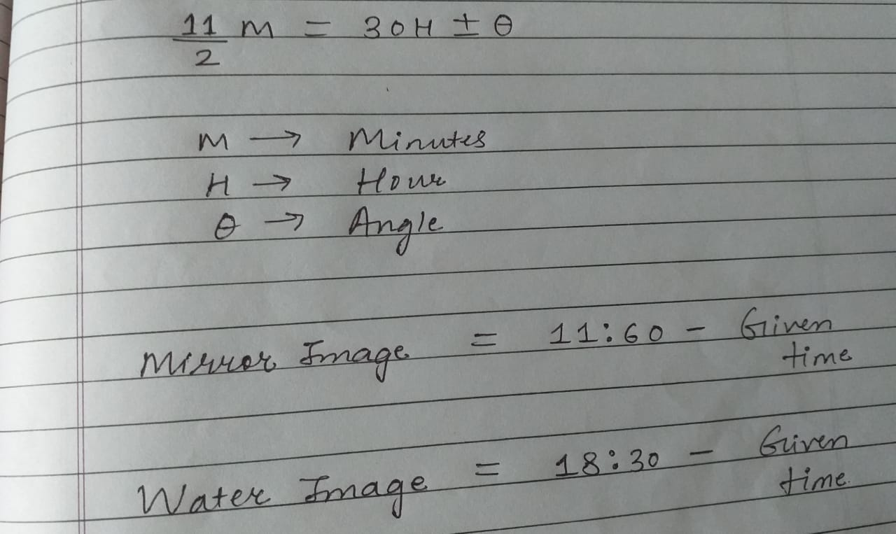

Slide 20
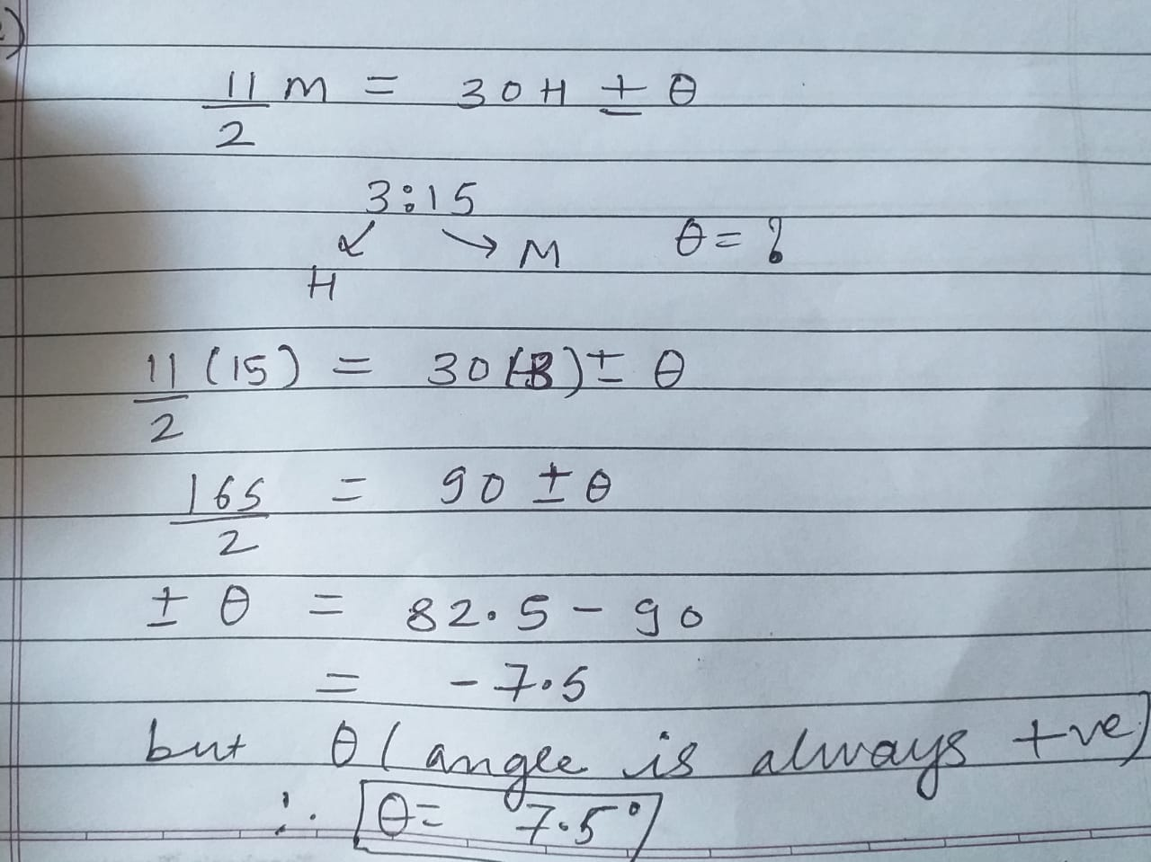

Slide 21
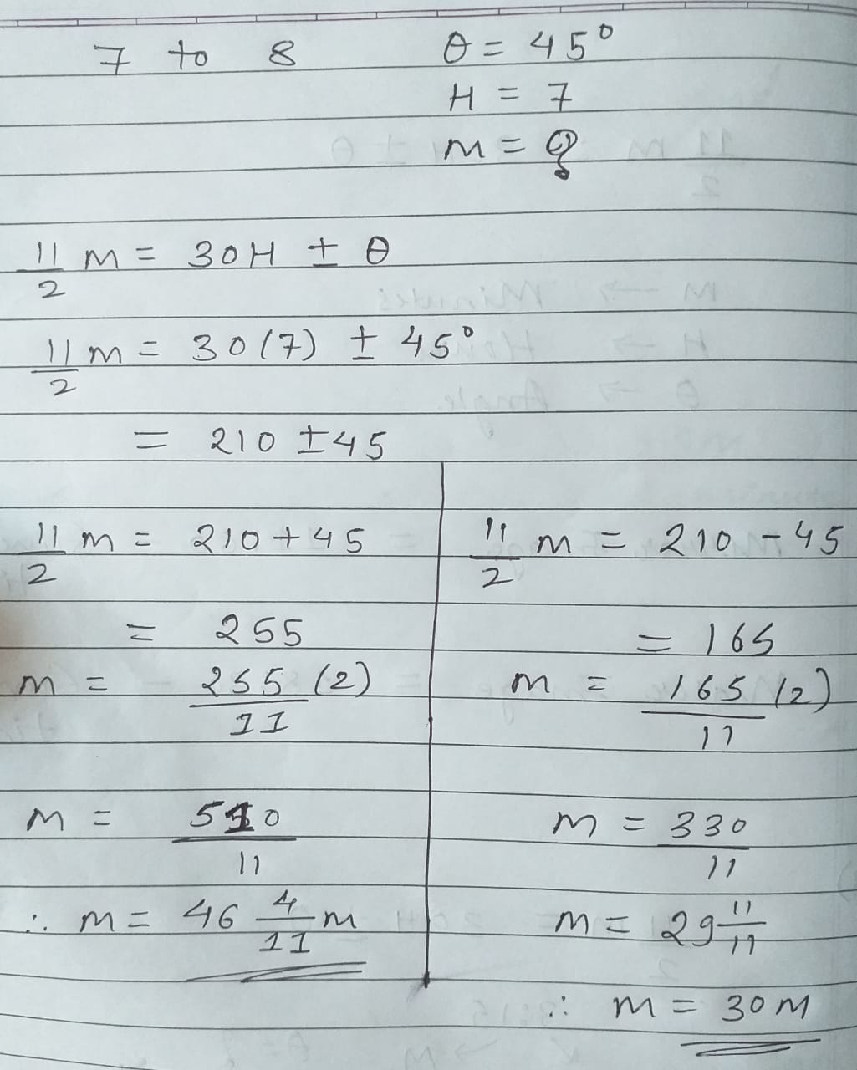

Slide 22
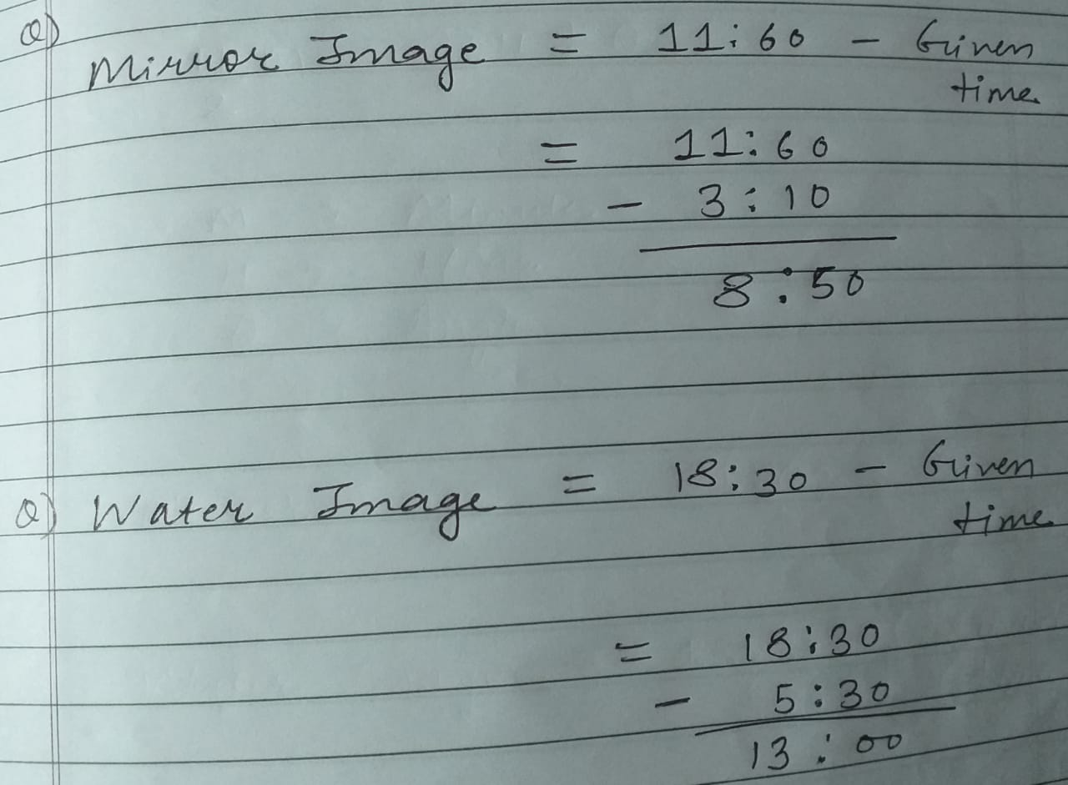

Slide 23
Points To Remember
Speed & Accuracy.
Presence of Mind.
Way of thinking.
Mathematics Basics. [as calculator is not allowed many times]
By heart Tricks and shortcuts to avoid confusion in exam.
Try solving Questions of different types.

Slide 24
Books & Websites
R.S. Aggarwal
Aptipedia
www.indiabix.com
https://www.indiabix.com/aptitude/questions-and-answers/
www.faceprep.in
https://www.faceprep.in/
www.sawaal.com
https://www.sawaal.com/aptitude-reasoning-questions-and-answers.html

Slide 25
Thank You

